Slide 1
IT2771 –
Rich Internet
Application Development
Cascading Style Sheets I

Slide 2
Recap …
Simple HTML5 document, with minimum required tags
<!DOCTYPE html>
<html>
<head>
<title>Title of document</title>
</head>
<body>
The content of document
</body>
</html>
Structural elements in HTML5 for page layout
<header>
<nav>
<section>
<aside>
<article>
<footer>

Slide 3
Learning Objectives
Learn how to create a basic Style Sheet
Learn how to use inheritance to write simpler style rules
Learn how to apply basic selection techniques

Slide 4

What is CSS?
CSS stands for Cascading Style Sheets
Styles define how to display HTML elements
Styles were added to HTML 4.0 to solve a problem → formatting a document
Styles are usually stored in external .css files

Slide 5
Benefits of CSS
Consistency
  Ensure consistent styling of web pages throughout the site
Flexible
  Can be written in one external file and assigned to HTML elements through class or ID properties
Save time
  Enable you to change the appearance and layout of all the pages in a Web site by editing one single file
Lightweight
  Smaller HTML files → web page loads faster
Separate style from content
  Same markup page presented in different viewing styles

Slide 6

CSS Style Rules
Style rules express the style characteristics for an HTML element
A set of style rules is called a style sheet
Style rules are easy to write and interpret
For Example:
p {color:blue;} → set all <p> elements in the document to blue text
Style rule composed of two parts: a selector and one or more declarations
  Selector: determines the element to which the rule is applied
  Declaration: contained within curly brackets, details the exact property values

Slide 7
CSS Style Rule Syntax
CSS rule has two main parts: a selector, and one or more declarations
  Selector: HTML element to be style
  Declaration: consists of property and value pair, CSS declaration always ends with a semicolon, and declaration groups are surrounded by curly brackets {}
    Property: a quality or characteristic followed by a colon (:)
    Such as color, font size, or margin
    Value: precise specification of property followed by a semicolon (;) Such as blue for color, 125% for font size, or 30px (pixels) for margin
Selector
Declaration
Declaration
h1
{ color: blue; font-size: 12px;}
Property
Value
Property
Value

Slide 8
CSS Comments
Comments are used to explain your CSS code
Are ignored by browsers
Begins with /* and ends with */
/*This is a comment*/
p {
text-align: center;
/*This is another comment*/
color: black;
font-family: arial;
}

Slide 9

CSS Id and Class
CSS allows you to specify own selectors called “id” and “class”
  id Selector
    Used to specify a style for a single, unique element
    Applied using the id attribute of HTML elements
    Defined with a hash “#”
#para1
{
text-align: center;
color: red;
font-family: arial;
}
Style rule applied to element with id=“para1”
<p id=“para1”>This is a paragraph with para1 style rule applied</p>
Do NOT start an ID name with a number!

Slide 10
CSS Id and Class
  class Selector
    Used to specify a style for a group of elements
    Allows you to set a particular style for many HTML elements with the same class
    Applied using the class attribute of HTML elements
    Defined with a dot “.”
.center
{
text-align:center;
}
Style rule applied to element with class=“center”
<p class=“center”>This is a paragraph with center class rule applied</p>
All <p> elements with class=“center” will be center-aligned
p.center { text-align:center; }
Do NOT start a class name with a number!

Slide 11
Combining CSS Style Rules with HTML
Browser reads a style sheet and format the document according to it
Three ways of inserting a style sheet
  Inline style
  Internal style sheet
  External style sheet
<!DOCTYPE html>
<html>
<head>
<title>What is HTML></title>
<link href=“styles.css” rel=“stylesheet” type=“text/css” />
<style type=“text/css”>
p {margin-left: 30px; }
</style>
</head>
<body>
<h1>What is HTML?</h1>
<p>HTML is a markup language, a <span style=“font-weight: bold;”> structured language</span> that lets you identify common sections of a document.</p>
</body>
</html>
<link> element points to external style sheet
Internal style sheet
External style sheet: styles.css
Inline style
body { font-family: arial; }
h1 { color: blue; }

Slide 12
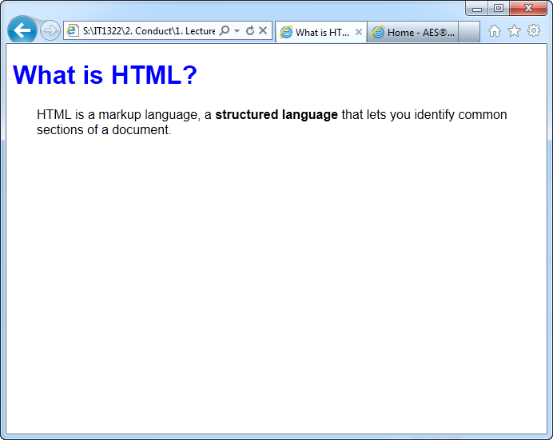
Combining CSS Style Rules with HTML
body { font-family: arial; }
h1 { color: blue; }
Rules in styles.css set the body text to Arial and the <h1> heading to the color blue
Internal style sheet make all paragraph elements within the document have a 30-pixel left margin
Inline style affects only the span of words it surrounds, making the words structured language bold
<style type=“text/css”>
p { margin-left: 30px; }
</style>
<span style=“font-weight: bold;”>
Notes:
Demo: cssdemo.html

Slide 13
Inline Style
<span style=“font-weight: bold;”>structured language</span>
Define style for a single element using the style attribute is called an inline style
Loses many advantages of style sheets by mixing content with presentation → use this method sparingly
Generally use style attribute to override style that was set at higher level in document
E.g.: you want a particular heading to be a different color from the rest of the headings in the page

Slide 14
Internal Style Sheet
Use <style> element to create an internal style sheet in the <head> section of the document
Style rules contained in internal style sheet only affect the document in which they are reside
  Value “text/css” of type attribute defines the language as Cascading Style Sheets
<head>
<style type=“text/css”>
p { margin-left: 30px; }
</style>
</head>

Slide 15
External Style Sheet
Placing style sheets in an external document lets you specify rules for multiple Web pages
Easy and powerful way to control styles for an entire Web site with one style sheet file
External style sheet is a text document that contains style rules and have a .css extension
Does not contain any HTML code, just CSS style rules, not an HTML document
  <link> element let you establish relationships between HTML document and external style sheet
  <link> element can only be used in the <head> section of a document
<head>
<link href=“styles.css” rel=“stylesheet” type=“text/css” />
</head>

Slide 16
Clean CSS Code
When creating external or internal style sheets, it is best to write CSS code that is consistent and easy to read
  Multiple declarations on the same line → fine for simple styles
  Hard to read when styles grow more complex
h1 { color: white; background-color: green; }
h1 { font-family: arial, helvetica, sans-serif; font-size: 85%; line-height: 110%; margin-left: 30px; }

Slide 17
Clean CSS Code
Style rule is easier to read and maintain if you use a cleaner, more organized format
Easier to read style rules → all properties are consistently left-aligned with their values on the right
h1 {
font-family: arial, helvetica, sans-serif;
font-size: 85%;
line-height: 110%;
margin-left: 30px;
}
Do NOT leave spaces between the property value and the unit (such as margin-left: 20 px)
Correct way: margin-left: 20px

Slide 18
Multiple Style Sheets
Some properties may have been set for the same selector in different style sheets
Multiple styles will cascade into one:
  Cascading order:
    Browser default
    External style sheet
    Internal style sheet (in the head section)
    Inline style (inside an HTML element)
  Inline style (inside an HTML element) has the highest priority and will override style defined inside the <head> tag, or in an external style sheet, or in a browser (a default value)
Lowest priority
Highest priority

Slide 19
Use inheritance to write simpler style rules
Elements in an HTML document are structured in a hierarchy of parent and child elements
<html>
  Parent elements contain nested elements called child elements
  Both <head> and <body> are immediate child of <html>
  Yet <body> is parent element for <h1>, <ul> and <p>
  Most CSS properties are inherit from parent elements to child elements, which is called inheritance
<head>
<title>
<body>
<h1>
<ul>
<li>
<p>
<em>

Slide 20
Use inheritance to write simpler style rules
Set color to red for five different elements in the document
Inheritance let you write a simpler to achieve the same results
<style type=“text/css”>
h1 { color: red; }
p { color: red; }
ul { color: red; }
em { color: red; }
li { color: red; }
</style
<style type=“text/css”>
body { color: red; }
</style

Slide 21
Basic Selection Techniques
Type Selectors
  Apply rule to every instance of the element in the document
  Simplest kind of selector
  Most style sheets are composed of type selector
body { color: gray; }
h2 { color: red; }
p { font-size: 85%; }

Slide 22
Basic Selection Techniques
Grouping Selectors
  Group selectors to which the same rules apply
  The following style rules set the same declaration for two different elements→ set color of <h1> and <h2> elements to red
  Two style rules can be expressed in a simpler way by grouping the selectors and separate them with commas (,)
h1 { color: red; }
h2 { color: red; }
h1, h2 { color: red; }

Slide 23
Basic Selection Techniques
Combining Declarations
  State multiple property declarations for the same selector
  The following style rules set the <p> element to 12-point and blue text
  Two style rules can be expressed in a simpler way by combining the declarations in one rule, separated by semicolons (;)
p { color: blue; }
p { font-size: 125%; }
p {
color: blue;
font-size: 125%;
}

Slide 24
Basic Selection Techniques
Descendant Selectors
  Also known as contextual selector, is based on hierarchical structure of elements
  The following style rule selects only <em> elements that are contained within <p> elements, all other <em> elements in the document are not affected
  The following rule selects <em> elements within <li> elements within <ul> elements only
p em { color: blue; }
Note: selector contains multiple elements, separated only by white space
ul li em { color: blue; }

Slide 25
Basic Selection Techniques
Universal Selectors
  Quickly select groups of elements and apply a style rule
  Symbol for universal selector is the asterisk (*)
  The following style rule set the default color for all elements within a document to blue
  Can also use universal selector to select all children of an element
  The following rule set all elements within a <div> element to tahoma typeface
* { color: blue; }
div * { font-family: tahoma; }

Slide 26
Basic Selection Techniques
Universal Selectors
  Universal selector is always overridden by more specific selectors
  The following style rules show a universal selector along with two other rules that have more specific selectors
    <h1> and <h2> rules override the universal selector for <h1> and <h2> elements
* { color: blue; }
h1 { color: red; }
h2 { color: black; }

Slide 27
Summary
CSS rules can be combined with your HTML code in a number of ways
  Inline
  Internal Style Sheet
  External Style Sheet
CSS rules are easy to write and read
CSS uses inheritance and cascading to determine which style rules take precedence
Basic style rules let you apply style rules based on standard element selectors
You can combine the selectors and declarations to create more powerful style expressions
You can also select elements based on contextual relationship of elements in the document tree

